Slide 1
Background

Slide 2
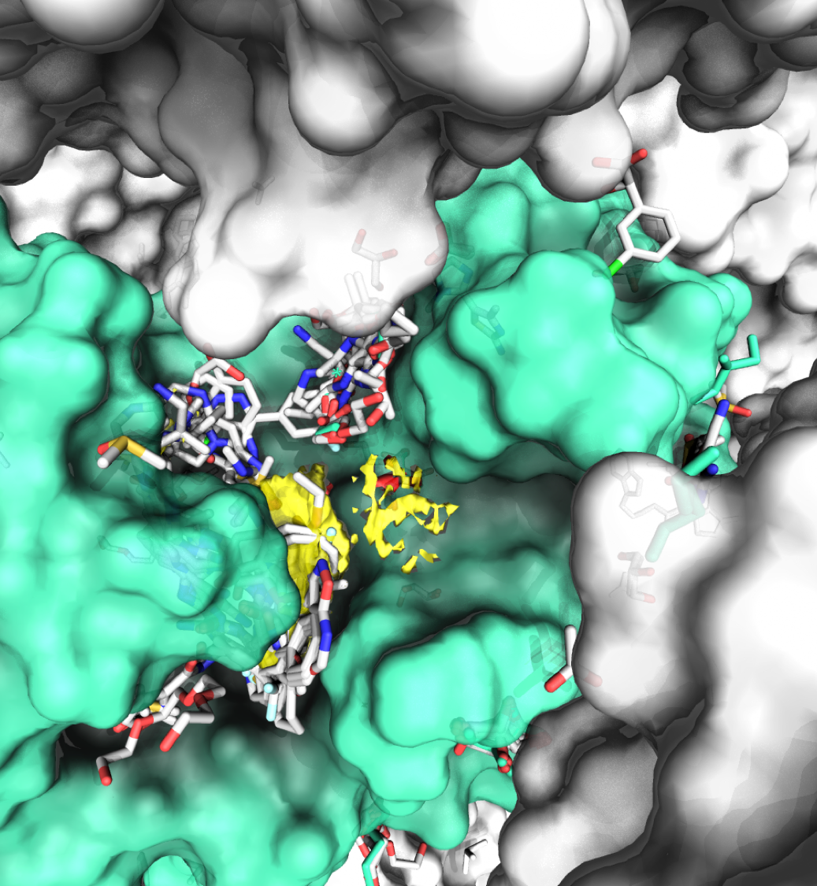
Protein Crystal Structures in Drug Discovery
Useful at multiple stages in drug discovery
Target tractability
Prioritisation of potential hits
Guide hit-to-lead development
Computational structure-based methods can be guided by prior knowledge
Important interactions

Slide 3
Fragment-Based Drug Design
Smaller, more simple compounds
MW 120-250
8-18 Heavy atoms
Simplicity allows them to bind efficiently, but at lower affinity
Affinity is gained by growing, merging or linking
Not all fragments make good starting points

Slide 4
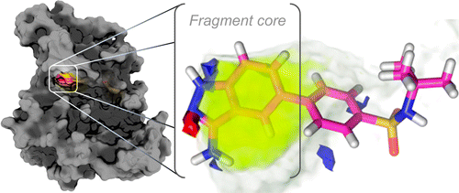
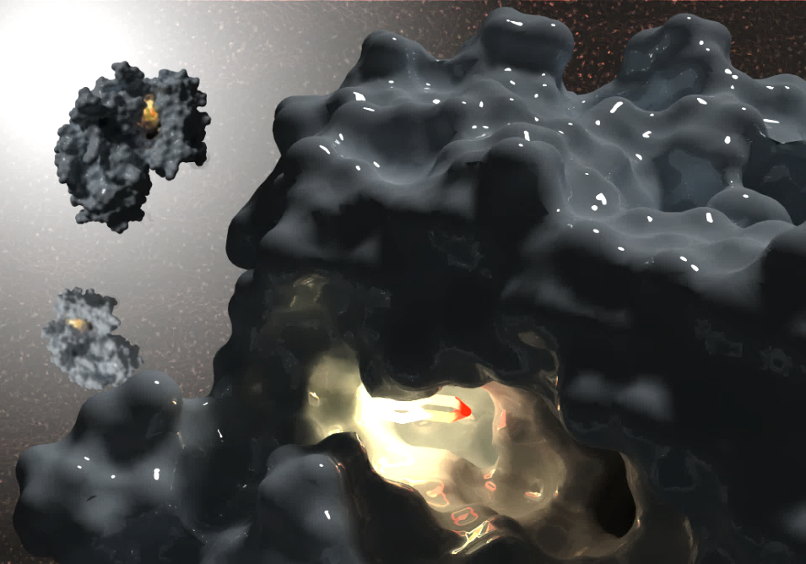
Hotspots
Strongly attractive to organic molecules
Cluster at hotspots in multiple solvent crystal structures
Capable of binding fragments
Overcome limited binding interface
Disproportionately large contribution to binding
Analogous to PPIs

Slide 5
Hotspots and Fragments
Chosen definition:
“The minimum binding site that will bind a fragment, maintaining the fragment binding position once it has been elaborated”
Fragment crystal structures to be used as a gold standard

Slide 6
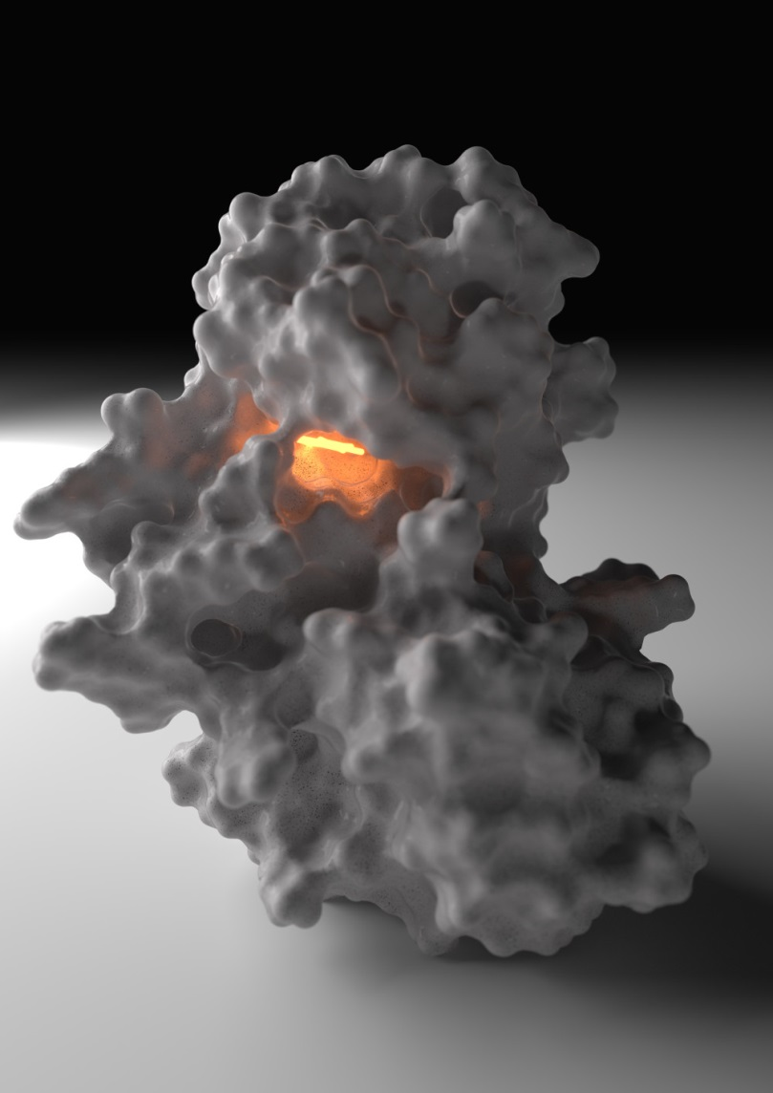
Fragment Hotspot Maps
Look for the environments that cause Hotspots
Aims:
Start from a global search of an apo protein
Find fragment binding sites
Predict the interactions made by fragments

Slide 7
Results

Slide 8
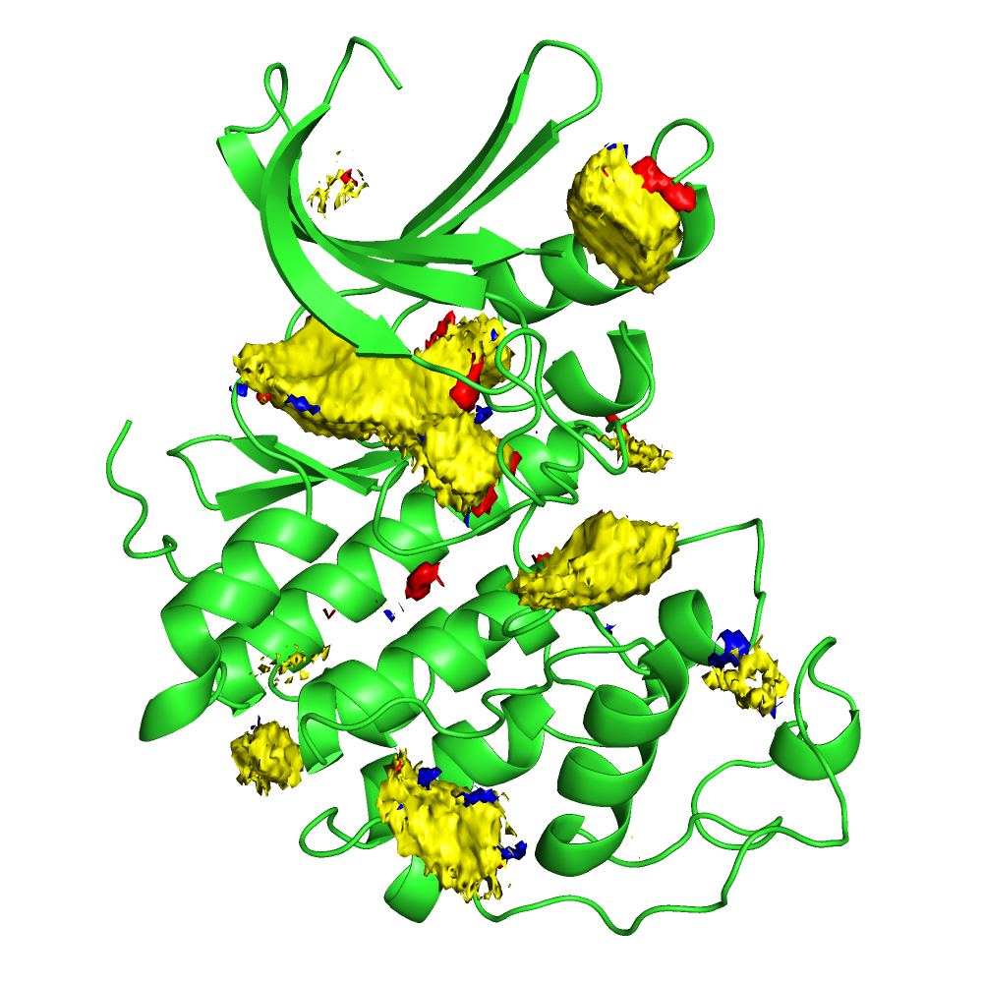
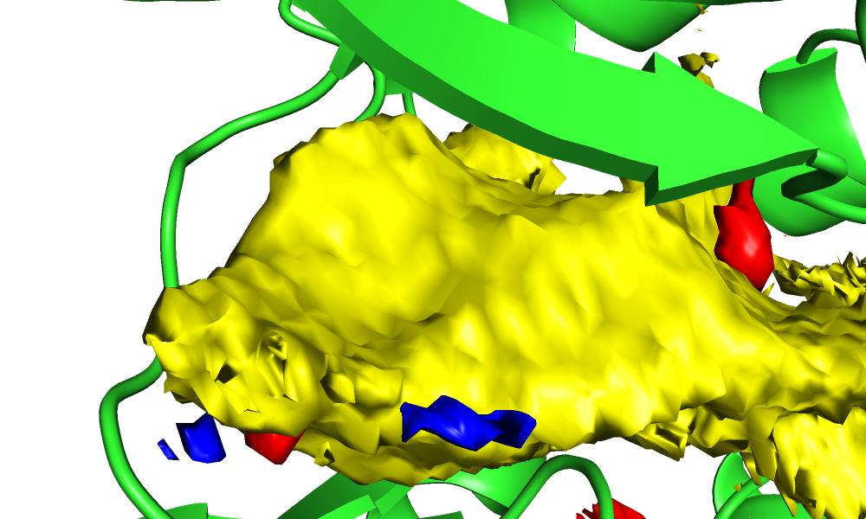
Displaying the Output
Contoured at: 10

Slide 9
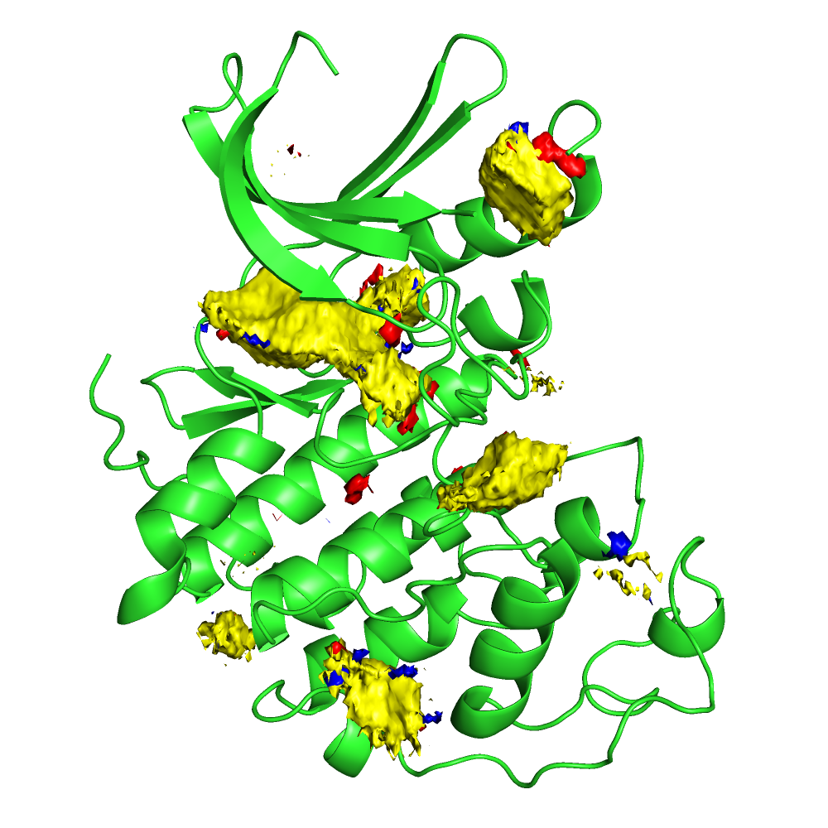
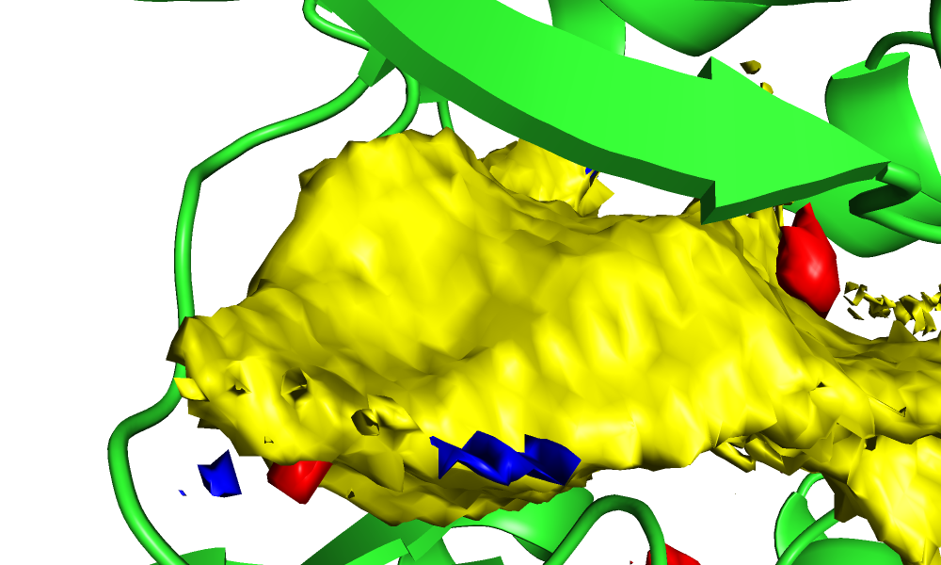
Displaying the Output
Contoured at: 11

Slide 10
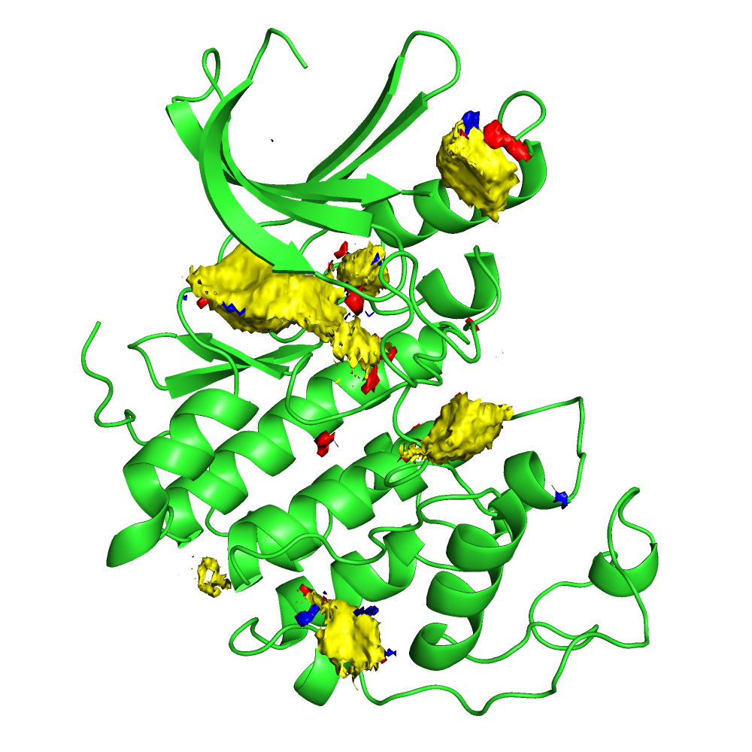
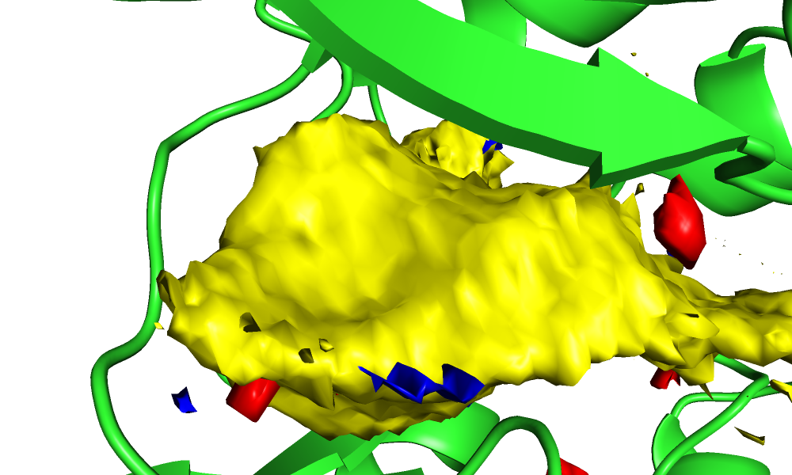
Displaying the Output
Contoured at: 12

Slide 11
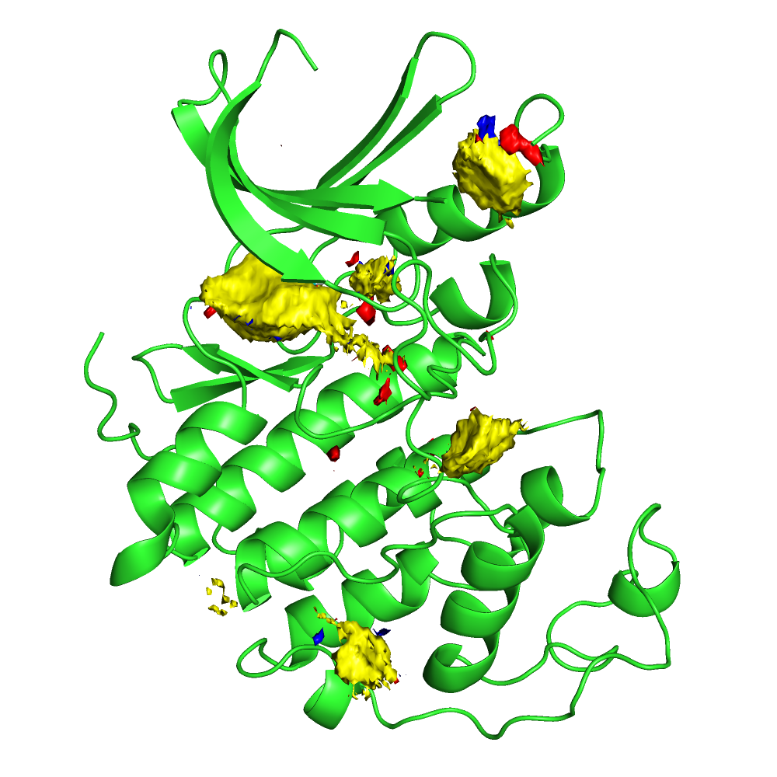
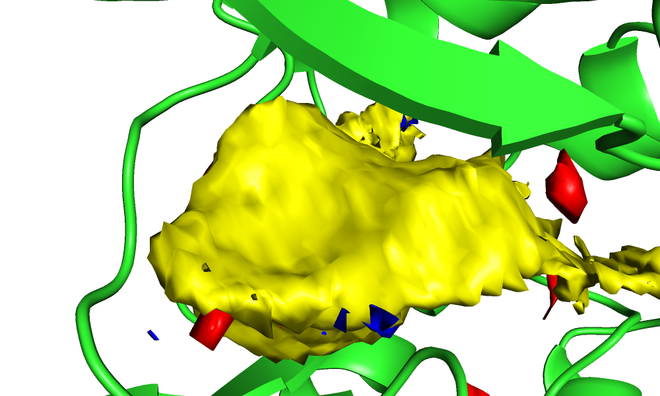
Displaying the Output
Contoured at: 13

Slide 12
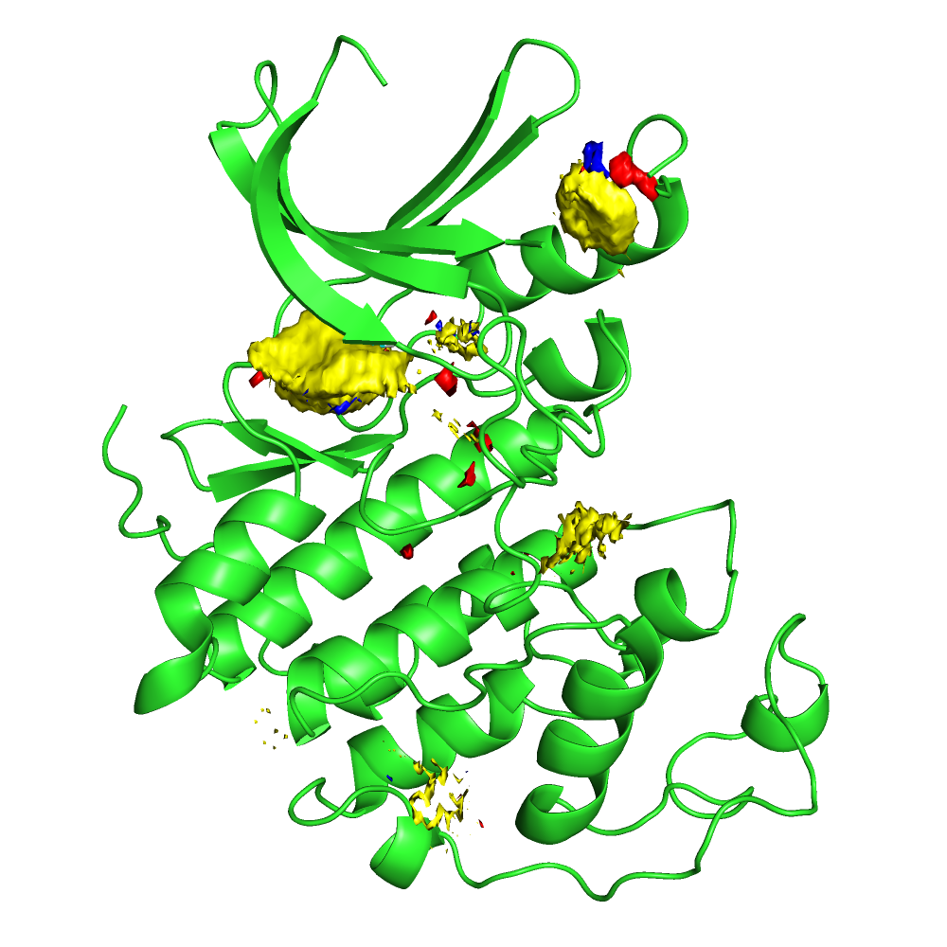
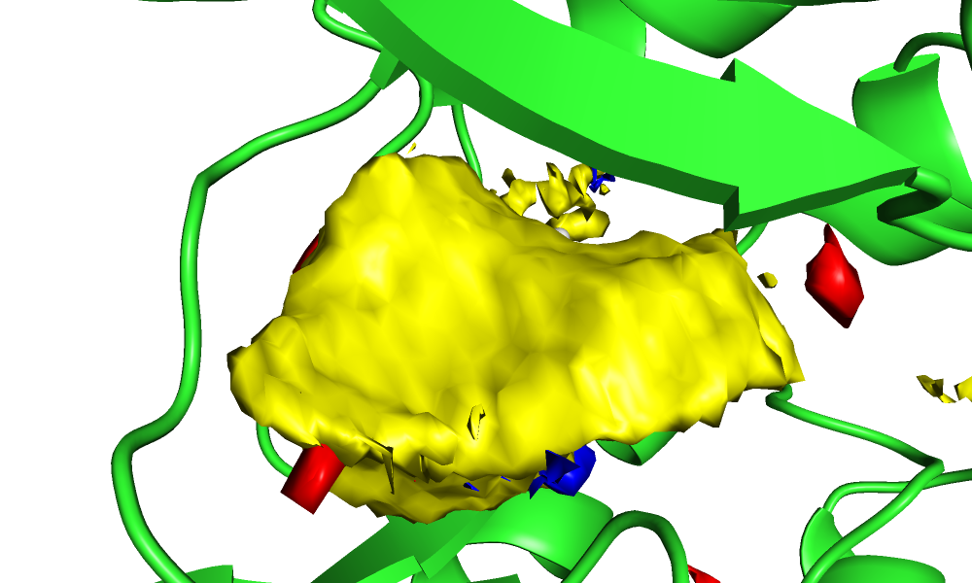
Displaying the Output
Contoured at: 14

Slide 13
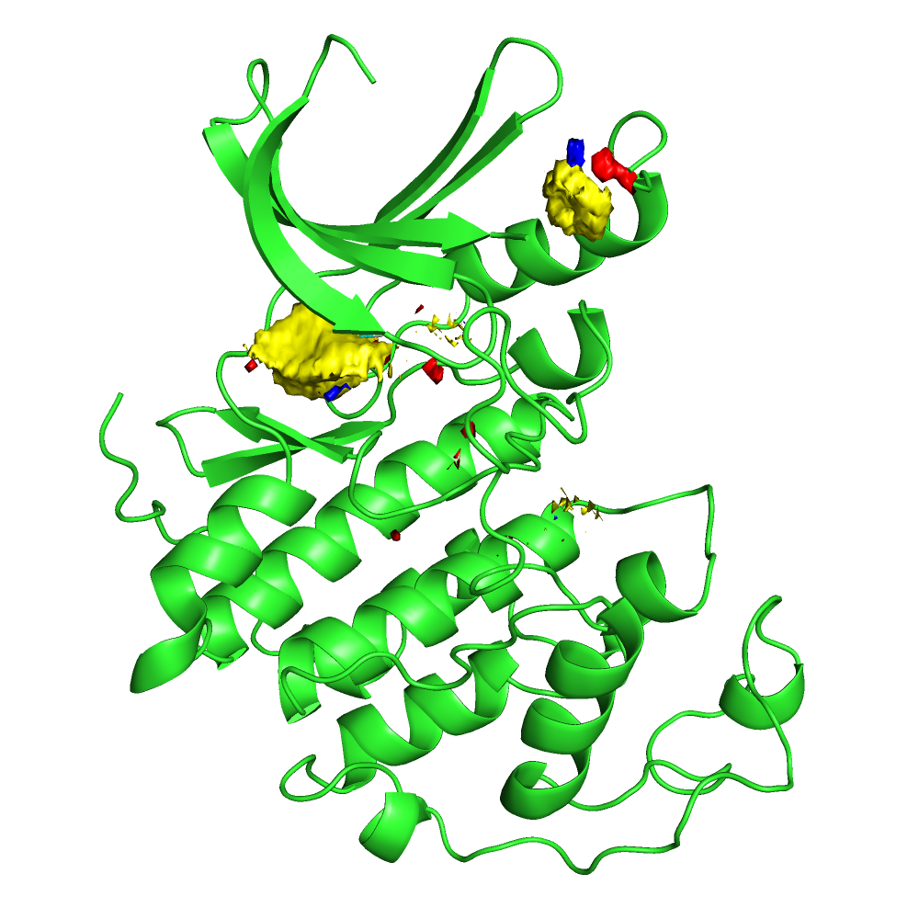
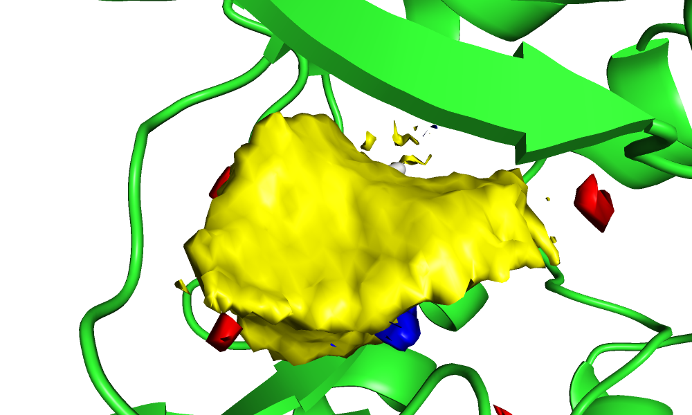
Displaying the Output
Contoured at: 15

Slide 14
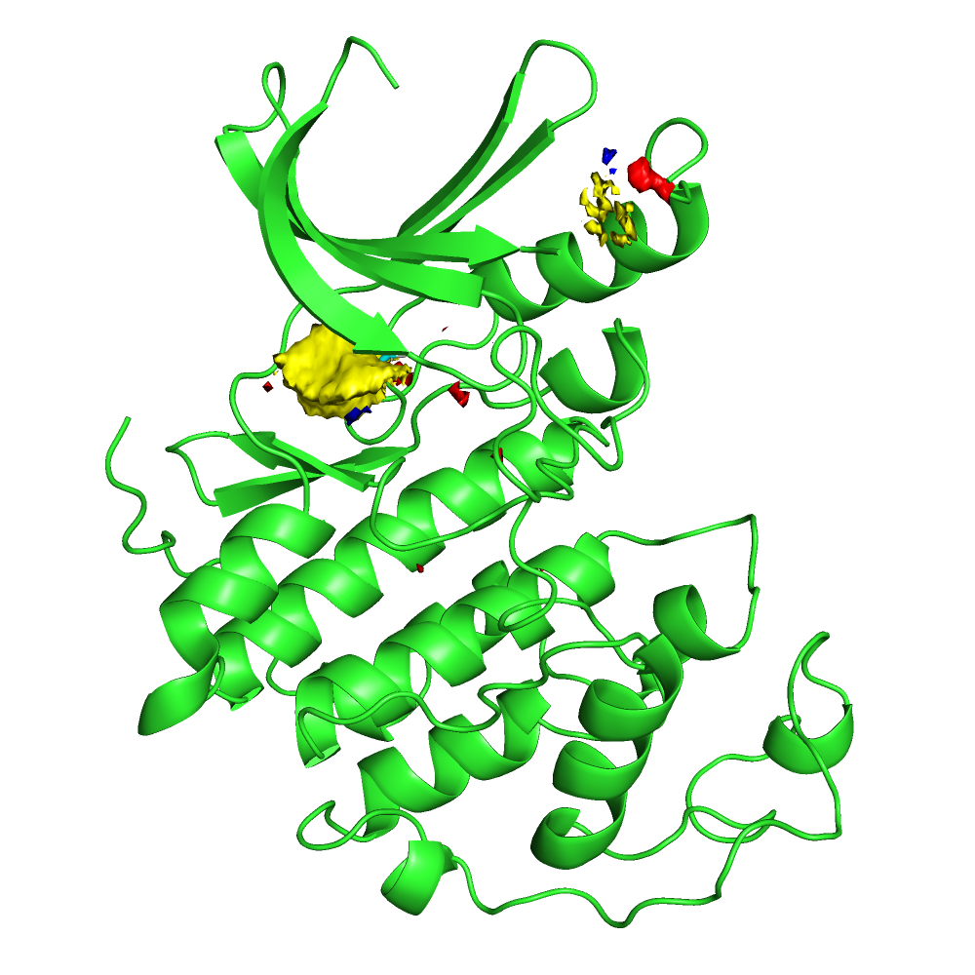
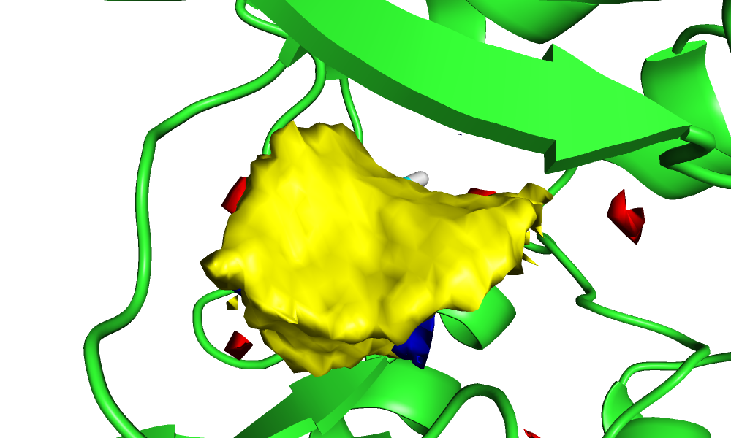
Displaying the Output
Contoured at: 16

Slide 15
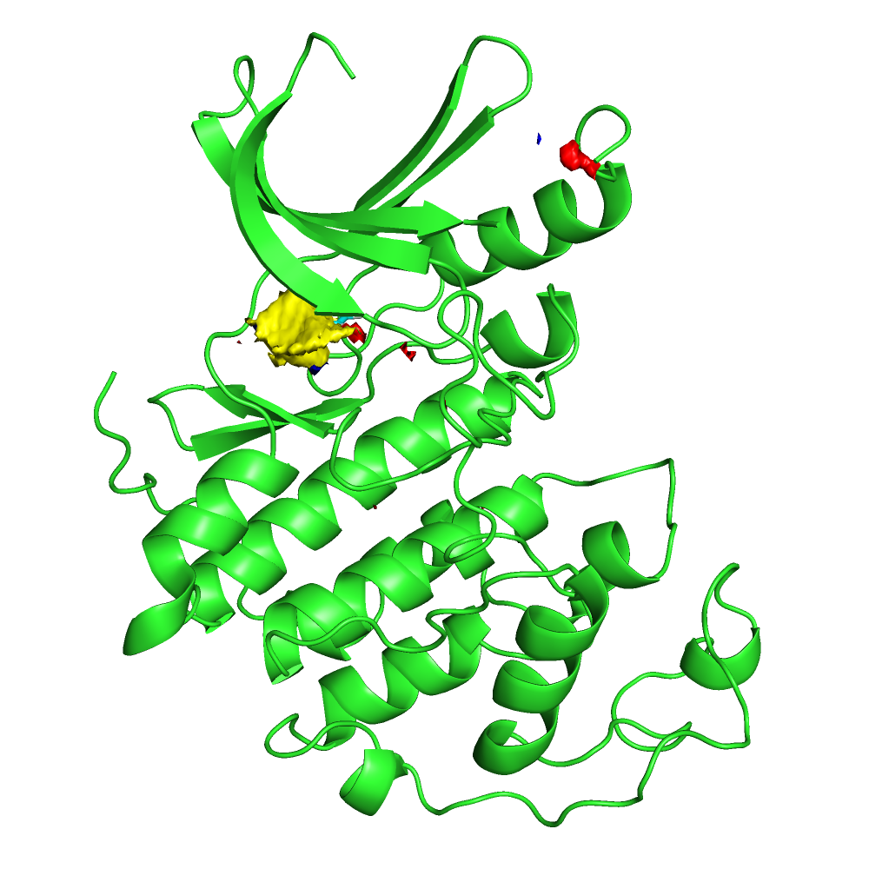
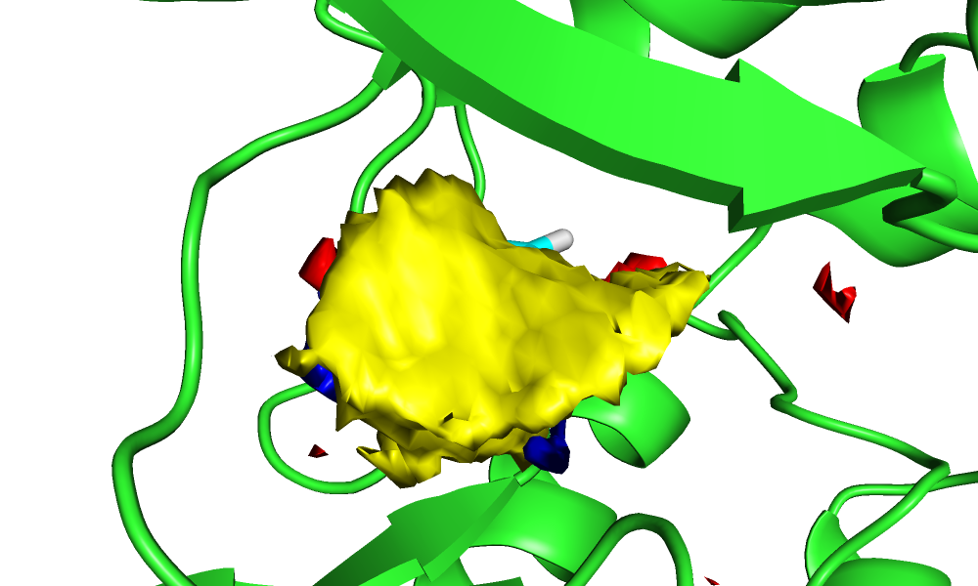
Displaying the Output
Contoured at: 17

Slide 16
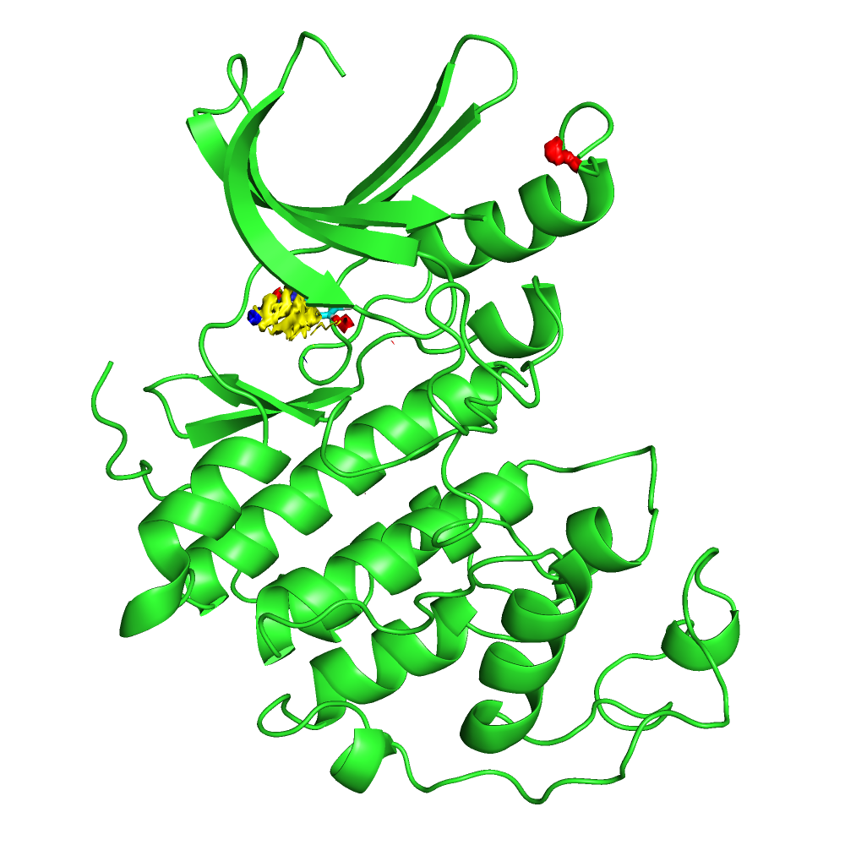
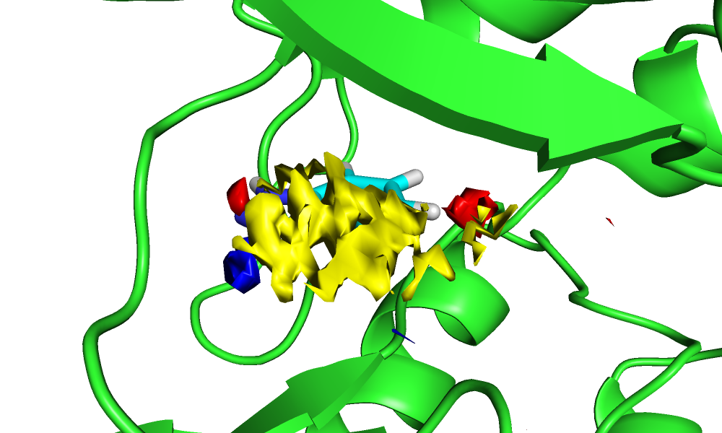
Displaying the Output
Contoured at: 18

Slide 17
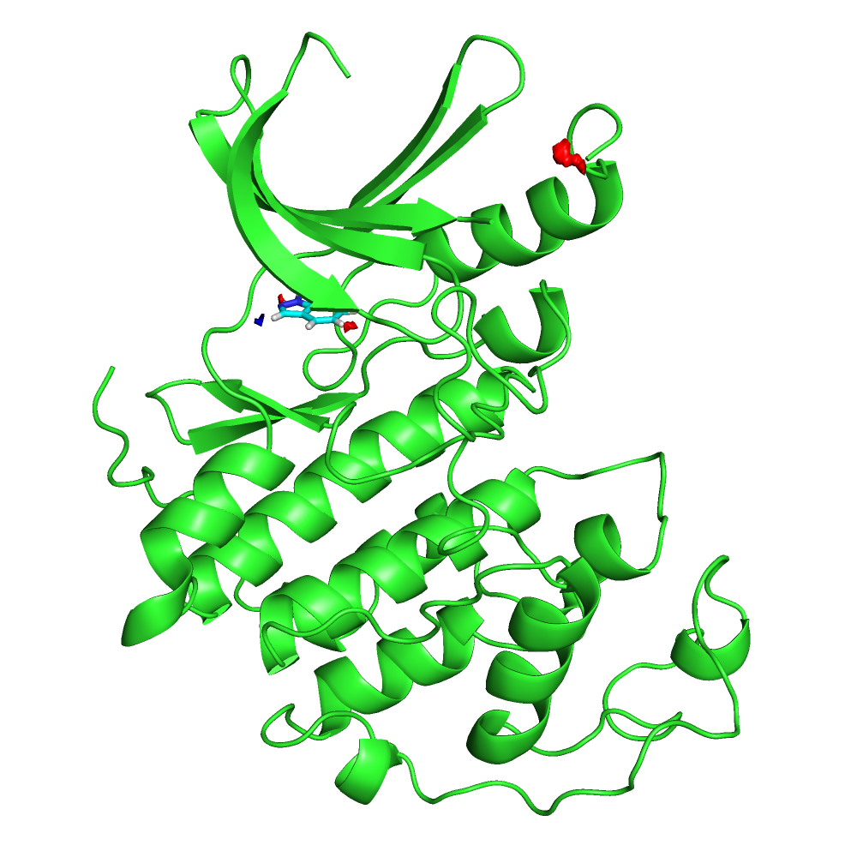
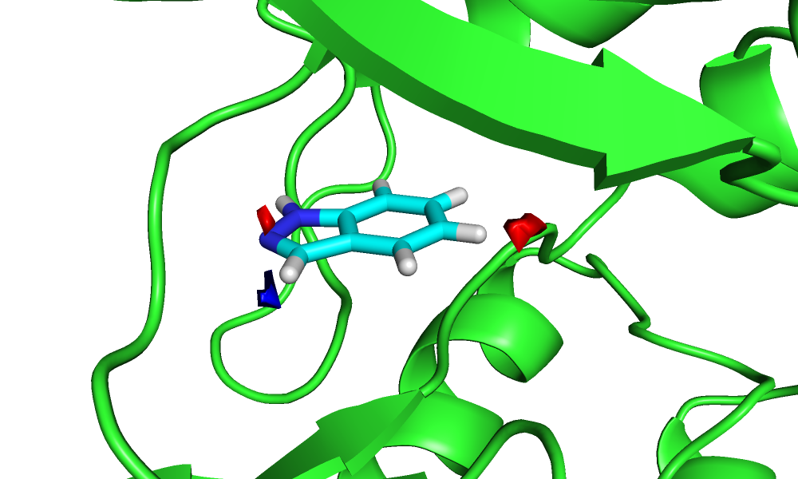
Displaying the Output
Contoured at: 19

Slide 18
Use case

Slide 19
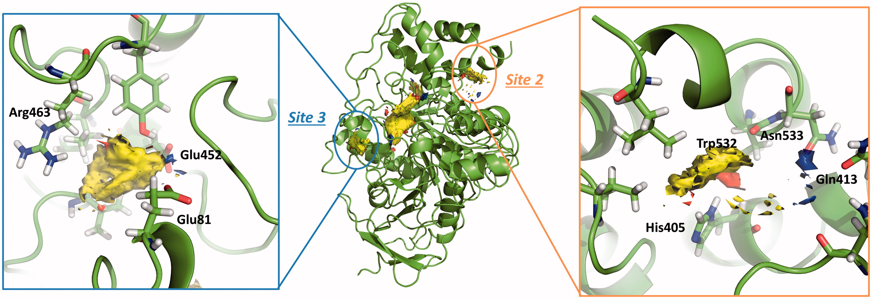
Gln413, Trp532, and His405 Filters for Virtual Screening

Slide 20
Webapp instructions

Slide 21
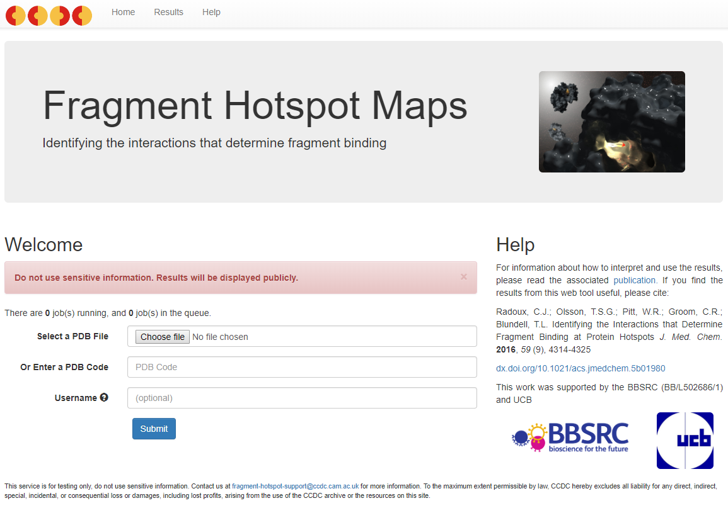
Web app
Option 1:
Select a PDB file
Enables user to manually prepare structure
Option 2:
Enter a PDB code directly
Sufficient for most users

Slide 22
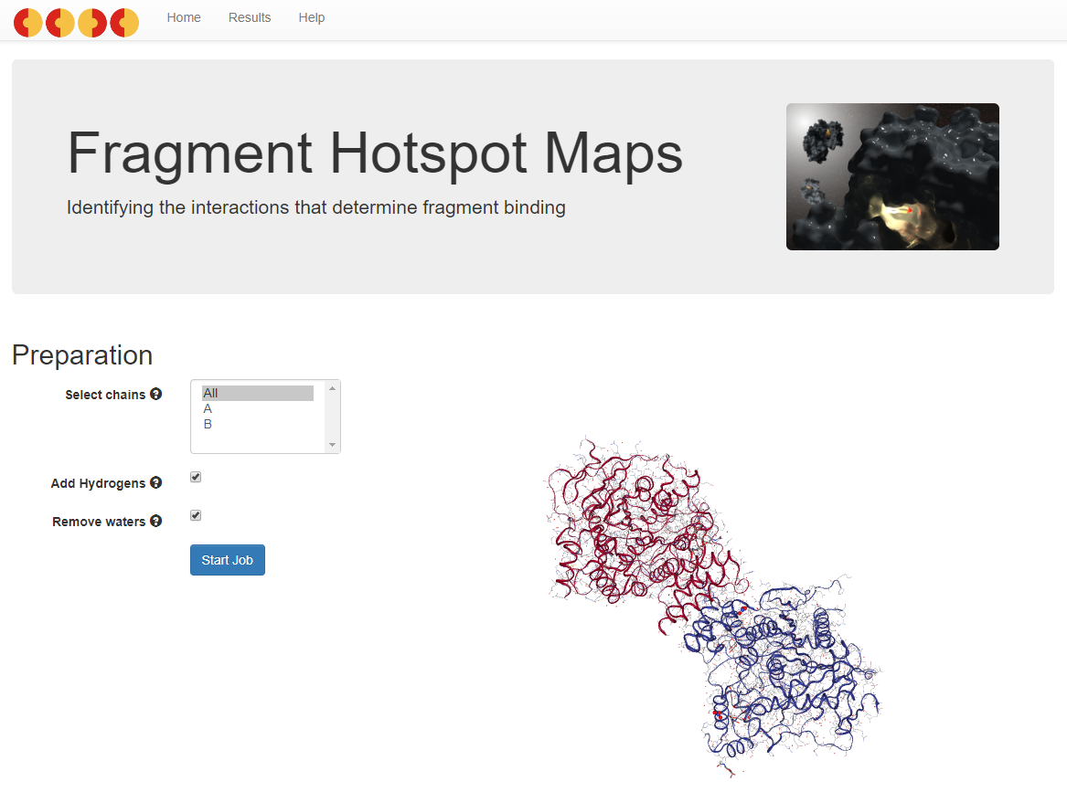
Web app
Preparation
Select chain
Add hydrogens (Important!)
Remove waters
Start Job

Slide 23
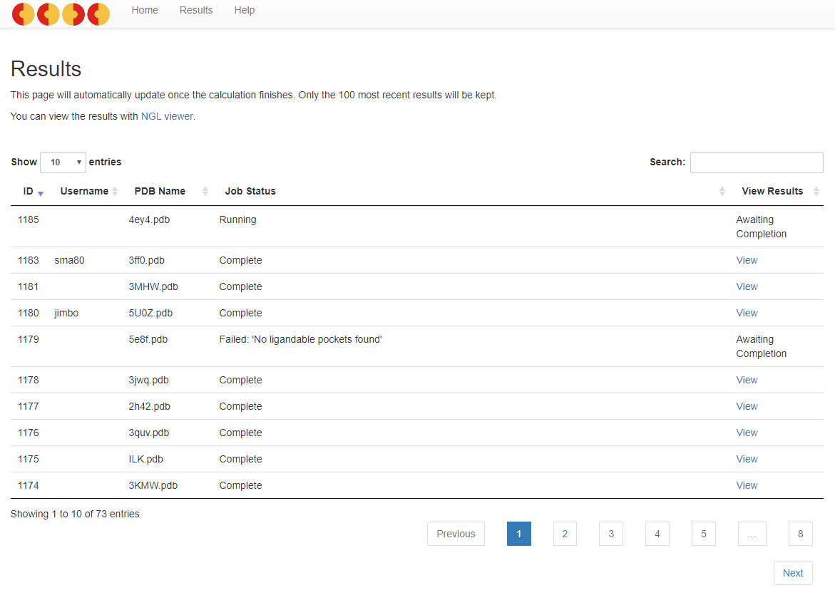
Web app
View results

Slide 24
Validation

Slide 25
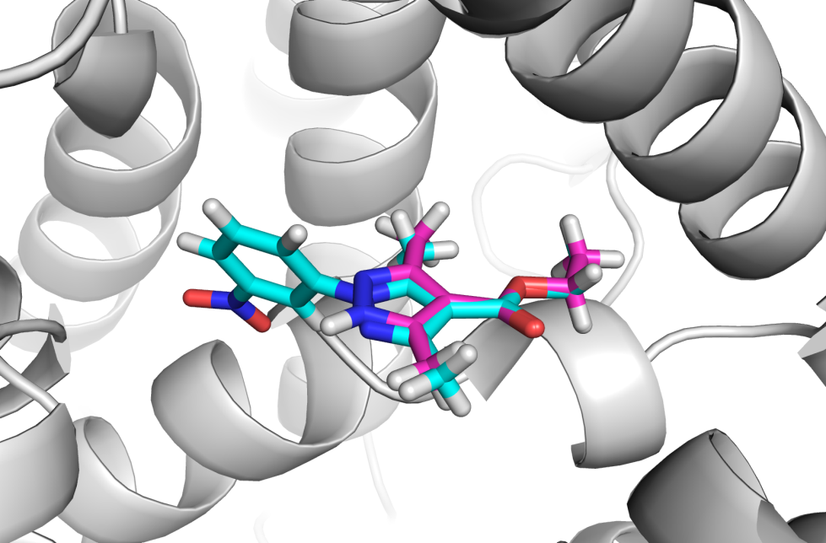
Validation
Dataset previously published by Ichihara and colleagues¹
Set of fragment- and lead-bound protein crystal structures
Fragment binding position maintained in lead
“The minimum binding site that will bind a fragment, maintaining the fragment binding position once it has been elaborated”
1. O. Ichihara, Y. Shimada and D. Yoshidome, ChemMedChem, 2014, 9, 2708–17.

Slide 26

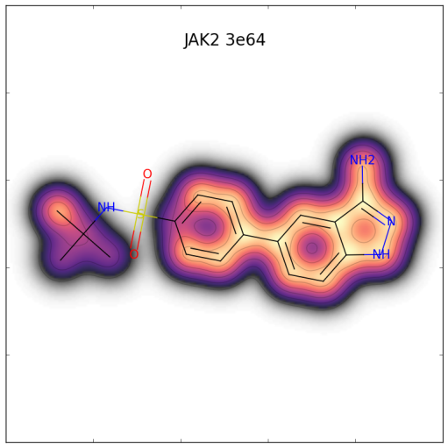
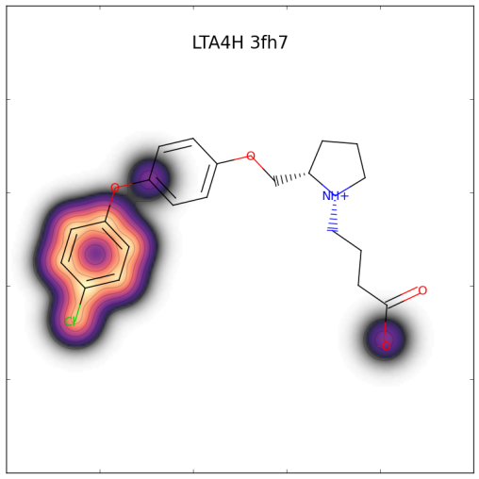
Validation
21 fragment and lead-bound protein crystal structures
We added corresponding apo structures
Maps calculated for apo structures
Scores assigned to ligand atoms
C. J. Radoux, T. S. G. Olsson, W. R. Pitt, C. R. Groom and T. L. Blundell, J. Med. Chem., 2016, 59, 4314–4325.

Slide 27
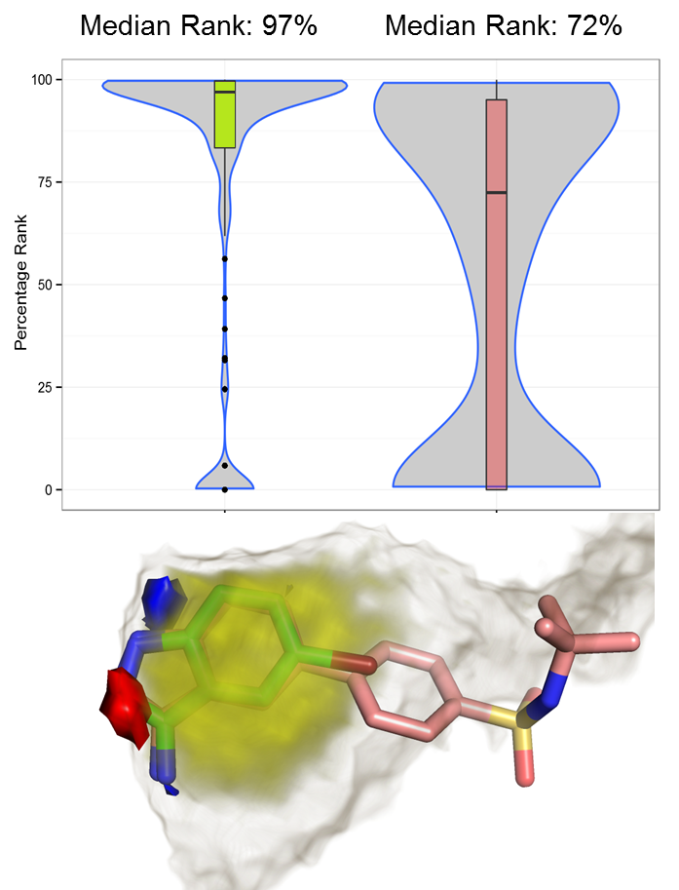
Results
Across whole dataset
Fragment atoms consistently high scoring
Beyond binding site prediction
Where can fragments bind?
Which interactions will the fragments make?
Fragment
Lead

Slide 28
Methodology

Slide 29
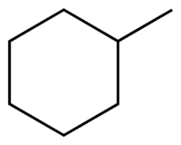
Representing Hotspot Environments
“Hydrogen bonds plus hydrophobic enclosure”
“Hydrophobic enclosure”
Use molecular probes that reflect hotspot environments

Slide 30
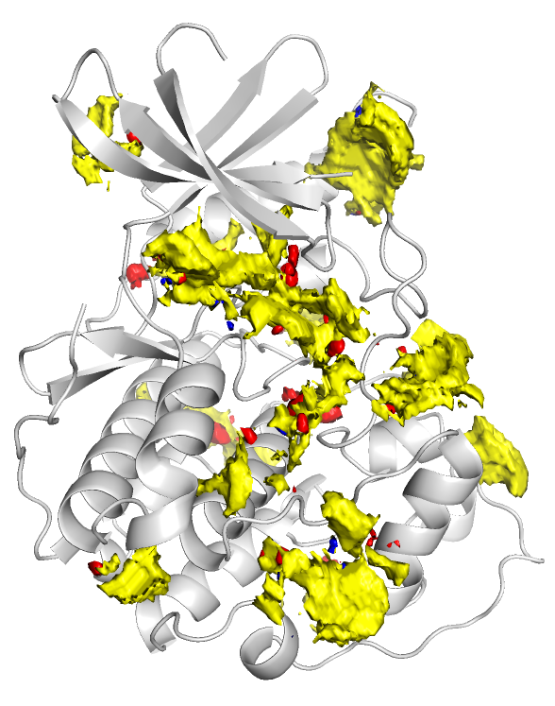
Atomic Propensities from SuperStar
SuperStar¹ is a grid-based method
Uses interaction data in the CSD
Generates atomic propensities
Red: Acceptor
Blue: Donor
Yellow: Hydrophobe
Reflects how likely a given atom will be found at that point
1. M. L. Verdonk, J. C. Cole and R. Taylor, J. Mol. Biol., 289, 1093-1108, 1999

Slide 31
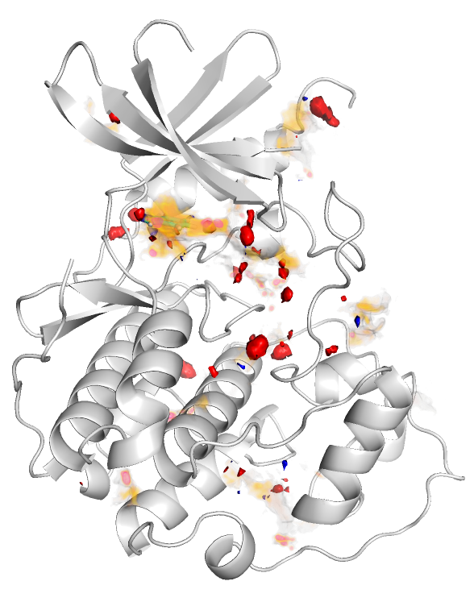
Introducing Enclosure
Multiply each propensity by the buriedness to represent enclosure
Buriedness calculated using LIGSITE¹
Weighted propensity
1. Hendlich, M.; Rippmann, F.; Barnickel, G. J. Mol. Graph. Model. 1997, 15 (6), 359–363, 389

Slide 32
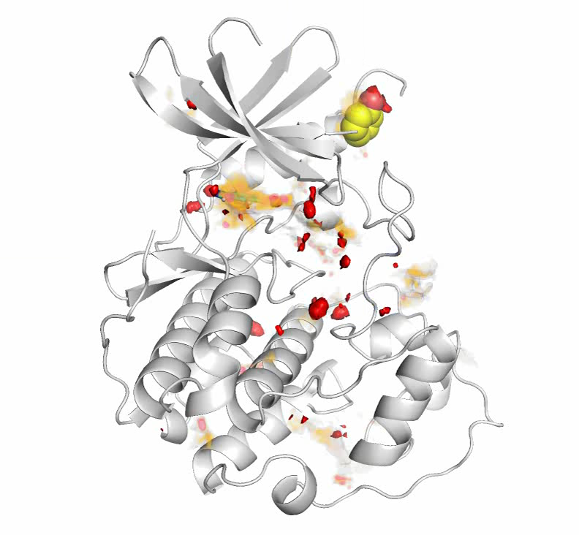
Sampling Example: Acceptor probe
Translate probe to high scoring acceptor grid points
2000 rotations
Probe score = Geometric mean of atom scores
55
15
19.7 = G.M
17
17
17
18
16

Slide 33
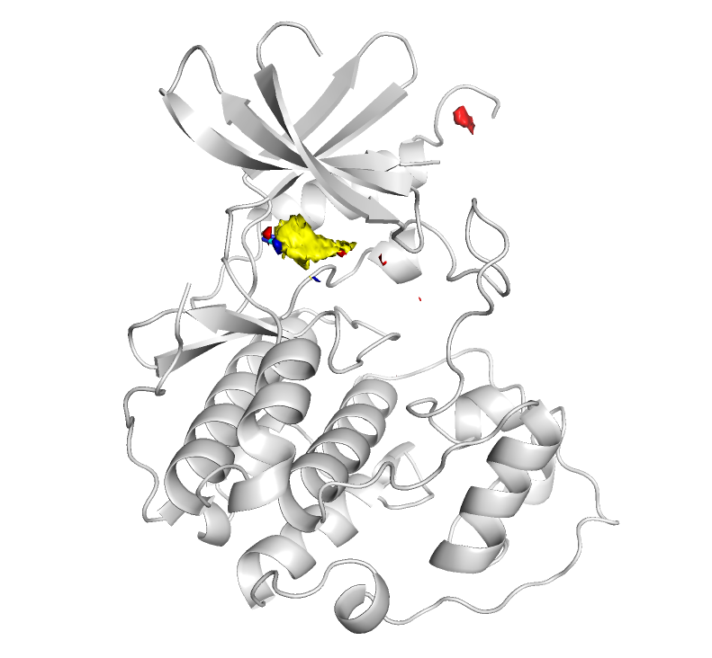
Creating Fragment Hotspot Maps
Probe scores assigned to a grid
High scoring regions:
High propensity for the polar atom (if applicable)
Environment is hydrophobic
Environment is enclosed
Probe size eliminates pockets too small for binding
5-10 minutes on a desktop

Slide 34
SuperStar Vs. Fragment Hotspot Maps
CSD SuperStar
Fragment Hotspot Maps

Slide 35
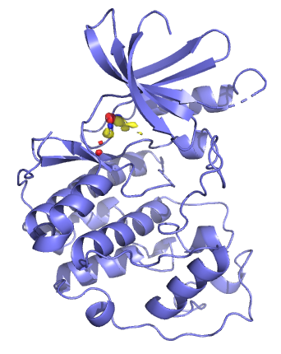
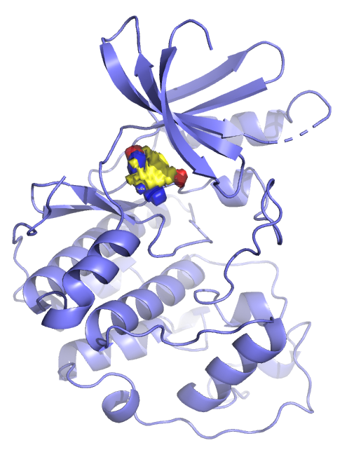
Experimental Data
Fragment Hotspot Data

